Slide 1
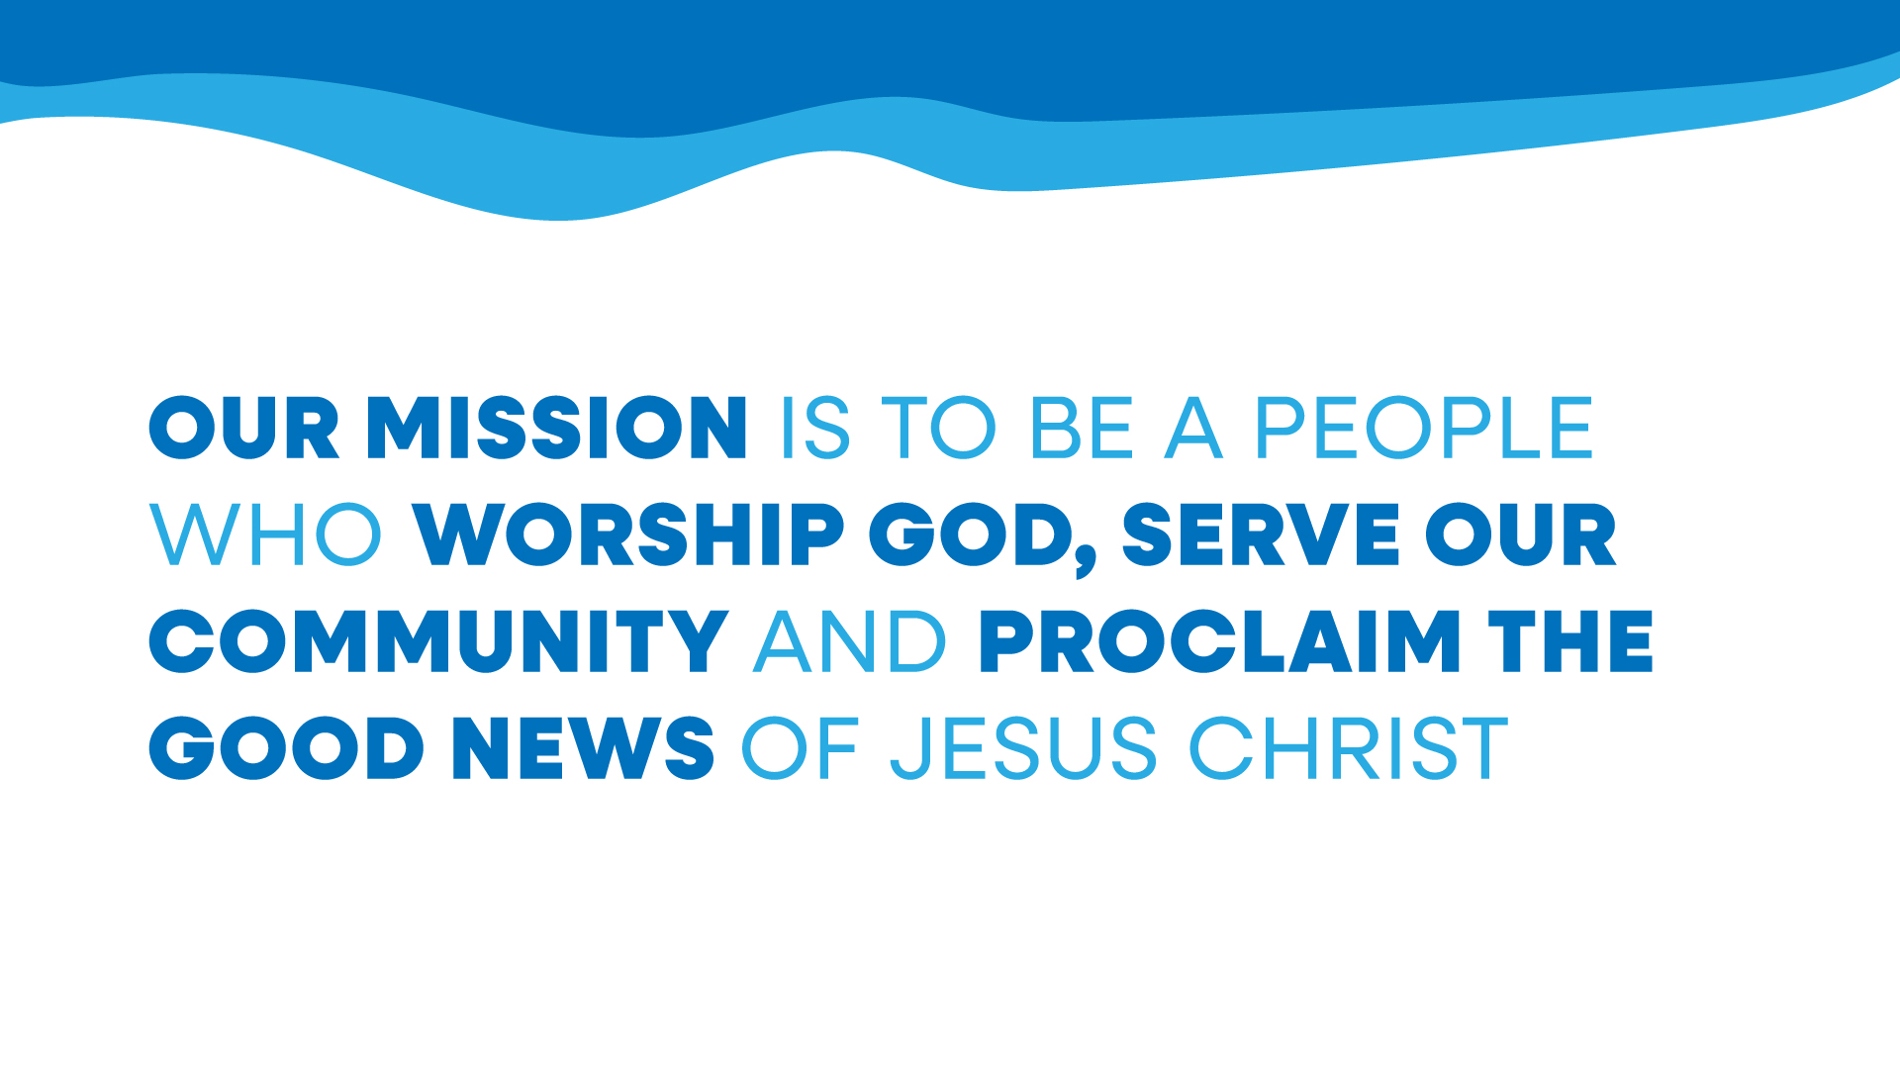

Slide 2
We are called to worship as a family of God’s people.
Deuteronomy 30: 11-20

Slide 3
Now what I am commanding you today is not too difficult for you or beyond your reach. It is not up in heaven, so that you have to ask,

Slide 4
“Who will ascend into heaven to get it and proclaim it to us so we may obey it?” Nor is it beyond the sea, so that you have to ask, “Who will cross the sea to get it and proclaim it to us so we may obey it?”

Slide 5
No, the word is very near you; it is in your mouth and in your heart so you may obey it.

Slide 6
See, I set before you today life and prosperity, death and destruction. For I command you today to love the Lord your God, to walk in obedience to him, and to keep his commands, decrees and laws;

Slide 7
then you will live and increase, and the Lord your God will bless you in the land you are entering to possess.

Slide 8
But if your heart turns away and you are not obedient, and if you are drawn away to bow down to other gods and worship them,

Slide 9
I declare to you this day that you will certainly be destroyed. You will not live long in the land you are crossing the Jordan to enter and possess.

Slide 10
This day I call the heavens and the earth as witnesses against you that I have set before you life and death, blessings and curses.

Slide 11
Now choose life, so that you and your children may live and that you may love the Lord your God, listen to his voice, and hold fast to him. For the Lord is your life, and he will give you many years in the land he swore to give to your fathers, Abraham, Isaac and Jacob.
Deuteronomy 30: 11-20

Slide 12



Slide 13

What is our hope in life and death

Slide 14
What is our hope in life and death
Christ alone Christ alone
What is our only confidence
That our souls to Him belong
Who holds our days within His hand
What comes apart from His command
And what will keep us to the end
The love of Christ in which we stand

Slide 15
O sing hallelujah
Our hope springs eternal
O sing hallelujah
Now and ever we confess
Christ our hope in life and death

Slide 16
What truth can calm the troubled soul
God is good God is good
Where is His grace and goodness known
In our great Redeemers blood
Who holds our faith when fears arise
Who stands above the stormy trial
Who sends the waves that bring us nigh
Unto the shore the rock of Christ

Slide 17
O sing hallelujah
Our hope springs eternal
O sing hallelujah
Now and ever we confess
Christ our hope in life and death

Slide 18
Unto the grave what will we sing
Christ He lives Christ He lives
And what reward will heaven bring
Everlasting life with Him
There we will rise to meet the Lord
Then sin and death will be destroyed
And we will feast in endless joy
When Christ is ours forevermore

Slide 19
O sing hallelujah
Our hope springs eternal
O sing hallelujah
Now and ever we confess
Christ our hope in life and death
CCLI 259001
Jordan Kauflin ¦Keith Getty ¦Matt Boswell ¦Matt Papa ¦Mathew Merker ©2020 Getty Music Hymns and Songs (Admin by Music Services, Inc) Getty Music Publishing (Admin by Music Services, Inc.) Love your enemies publishing (Admin by Music Services, Inc) Messenger Hymns (Admin by Music Services Inc) Jordan Kauflin Music (Admin by Song Solutions www.songsolutions.org) Matthew Merker Music (Admin by Song Solutions www.songsolutions.org)
Northern Ireland Charity Number NIC 105562

Slide 21
We read God’s word as a family of God’s people.

Slide 23
We worship God with songs of praise and our offering.

Slide 24
IPH 270
Jesus loves me this I know

Slide 25
Jesus loves me! This I know,
For the Bible tells me so.
Little ones to Him belong;
They are weak, but He is strong.

Slide 26
Yes, Jesus loves me!
Yes, Jesus loves me!
Yes, Jesus loves me!
The Bible tells me so

Slide 27
Jesus loves me! He who died
Heaven's gate to open wide;
He will wash away my sin,
Let His little child come in.

Slide 28
Yes, Jesus loves me!
Yes, Jesus loves me!
Yes, Jesus loves me!
The Bible tells me so

Slide 29
Jesus loves me, He will stay
Close beside me all the way;
Then His little child will take
Up to Heaven for His dear sake

Slide 30
Yes, Jesus loves me!
Yes, Jesus loves me!
Yes, Jesus loves me!
The Bible tells me so

Slide 32
You, God, are my God, earnestly I seek you; I thirst for you, my whole being longs for you, in a dry and parched land where there is no water.

Slide 33
I have seen you in the sanctuary and beheld your power and your glory. Because your love is better than life, my lips will glorify you. I will praise you as long as I live, and in your name I will lift up my hands. I will be fully satisfied as with the richest of foods; with singing lips my mouth will praise you.

Slide 34
On my bed I remember you; I think of you through the watches of the night. Because you are my help, I sing in the shadow of your wings. I cling to you; your right hand upholds me.
Psalm 63: 1-8

Slide 35
We worship God with songs of praise.

Slide 36
IPH 488 As the deer pants for the water

Slide 37
As the deer pants for the water, so my soul longs after You.
You alone are my heart’s desire and I long to worship You.

Slide 38
You alone are my strength, my shield, to You alone may my spirit yield.
You alone are my heart’s desire and I long to worship You.

Slide 39
I want You more than gold or silver, only You can satisfy.
You alone are the real joy-giver and the apple of my eye.

Slide 40
You alone are my strength, my shield, to You alone may my spirit yield.
You alone are my heart’s desire and I long to worship You.

Slide 41
You’re my friend and You are my brother, even though You are a king.
I love You more than any other, so much more than anything.

Slide 42
You alone are my strength, my shield, to You alone may my spirit yield.
You alone are my heart’s desire and I long to worship You.
CCLI 259001
IPH 488 As the deer pants for the water,
Martin J. Nystrom, b 1956
Northern Ireland Charity Number NIC 0105562

Slide 43
Turn your eyes

Slide 44
Turn your eyes upon Jesus, look full in his wonderful face,
And the things of earth will grow strangely dim in the light of his glory and grace

Slide 45
Jesus, to you we lift our eyes,
Jesus, our glory and our prize.
We adore you, behold you, our Saviour ever true.
Oh Jesus, we turn our eyes to you.

Slide 46
Turn your eyes to the hillside where justice and mercy embrace.
There the Son of God have his life for us, and our measureless debt was erased.

Slide 47
Jesus, to you we lift our eyes,
Jesus, our glory and our prize.
We adore you, behold you, our Saviour ever true.
Oh Jesus, we turn our eyes to you.

Slide 48
Turn your eyes to the morning and see Christ the lion awake.
What a glorious dawn: fear of death is gone, for we carry his life in our veins.

Slide 49
Jesus, to you we lift our eyes,
Jesus, our glory and our prize.
We adore you, behold you, our Saviour ever true.
Oh Jesus, we turn our eyes to you.

Slide 50
Turn your eyes to the heavens, our King will return for his own.
Ev’ry knee will bow, ev’ry tongue will shout,
“All the glory to Jesus alone!”

Slide 51
Jesus, to you we lift our eyes,
Jesus, our glory and our prize.
We adore you, behold you, our Saviour ever true.
Oh Jesus, we turn our eyes to you.

Slide 52
We draw close to God in prayer.

Slide 53
God speaks into our lives through his word.
Luke 9: 18-27

Slide 54
Once when Jesus was praying in private and his disciples were with him, he asked them, “Who do the crowds say I am?”

Slide 55
They replied, “Some say John the Baptist; others say Elijah; and still others, that one of the prophets of long ago has come back to life.”
“But what about you?” he asked. “Who do you say I am?”
Peter answered, “God’s Messiah.”

Slide 56
Jesus strictly warned them not to tell this to anyone. And he said, “The Son of Man must suffer many things and be rejected by the elders, the chief priests and the teachers of the law, and he must be killed and on the third day be raised to life.”

Slide 57
Then he said to them all: “Whoever wants to be my disciple must deny themselves and take up their cross daily and follow me. For whoever wants to save their life will lose it, but whoever loses their life for me will save it.

Slide 58
What good is it for someone to gain the whole world, and yet lose or forfeit their very self? Whoever is ashamed of me and my words, the Son of Man will be ashamed of them when he comes in his glory and in the glory of the Father and of the holy angels.

Slide 59
“Truly I tell you, some who are standing here will not taste death before they see the kingdom of God.”
Luke 9: 18-27

Slide 60
We respond to God’s word in prayer and song.

Slide 61
Mission Praise 58 Blessed Assurance

Slide 62
Blessèd Assurance, Jesus is mine:
O what a foretaste of glory divine!
Heir of salvation, purchase of God;
Born of His Spirit, washed in His blood.

Slide 63
This is my story, this is my song,
Praising my Saviour all the day long.
This is my story, this is my song,
Praising my Saviour all the day long.

Slide 64
Perfect submission, perfect delight,
Visions of rapture burst on my sight;
Angels descending bring from above
Echoes of mercy, whispers of love.

Slide 65
This is my story, this is my song,
Praising my Saviour all the day long.
This is my story, this is my song,
Praising my Saviour all the day long.

Slide 66
Perfect submission, all is at rest,
I in my Saviour am happy and blessed;
Watching and waiting, looking above,
Filled with His goodness, lost in His love.

Slide 67
This is my story, this is my song,
Praising my Saviour all the day long.
This is my story, this is my song,
Praising my Saviour all the day long.

Slide 69
We serve in God’s world proclaiming the name of Jesus.

Slide 70
IPH 33 ‘O Worship the King’

Slide 71
O worship the King, all glorious above;
O gratefully sing
His power and His love:
Our shield and defender, the Ancient of Days, pavilioned in splendour and girded with praise!

Slide 72
O tell of His might!
O sing of His grace, whose robe is the light, whose canopy space!
His chariots of wrath the deep thunder clouds form, and dark in His path on the wings of the storm.

Slide 73
The earth, with its store of wonders untold,
Almighty, your power has founded of old, established it fast by a changeless decree, and round it has cast, like a mantle, the sea.

Slide 74
Your bountiful care what tongue can recite?
It breathes in the air, it shines in the light, it streams from the hills, it descends to the plain, and sweetly distils in the dew and the rain.

Slide 75
Frail children of dust and feeble as frail, in You do we trust, nor find You to fail;
Your mercies how tender, how firm to the end; our maker, defender, redeemer and friend!

Slide 76
O measureless might!
O infinite love!
While angels delight to praise You above,
Your ransomed creation, with glory ablaze, with true adoration shall sing to your praise!

Slide 77



Grace of Jesus
Love of God
Fellowship of the Holy Spirit

Slide 78


